Slide 1

Basics of Decision Making
Unit 4

Slide 2

Creativity is the “cognitive process of developing an idea, concept, commodity, or discovery that is viewed as novel by its creator or a target audience.”
— Max H. Bazerman

Slide 3

What is creative thinking?
Creative thinking refers to using abilities and soft skills to come up with new solutions to problems.
Creative thinking skills are techniques used to look at the issue from different and creative angles, using the right tools to assess it and develop a plan.

Slide 4
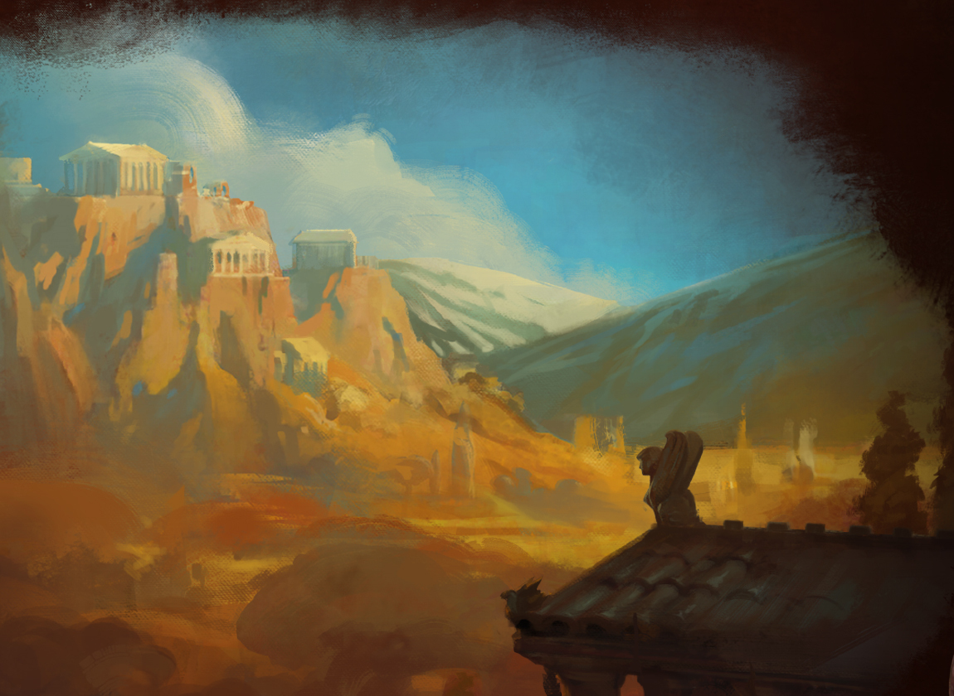
What are the main benefits of creative thinking?
Create The Best Solutions
Problem-solving
Workplace Involvement
Understanding of Data
Self-improvement
Teamwork And Bonding

Slide 5
Creative Thinking Techniques
Brainstorming
Lateral thinking
Mind Mapping

Slide 6

The Creativity Process Requires
Convergent Thinking
Divergent Thinking

Slide 7
Strategies to Enhance Creativity
Creativity techniques
Knowledge management
Resource Allocation
Allowing Freedom

Slide 8
Common Barriers to Creativity in Business
Lack of Autonomy
Unclear Direction
Fear
Inadequate Resources
Functional Fixedness

Slide 9
Decision Making
According to D. E. McFarland
“A decision is an act of choice – wherein an executive forms a conclusion about what must not be done in a given situation. A decision represents a course of behavior chosen from a number of possible alternatives”.

Slide 10
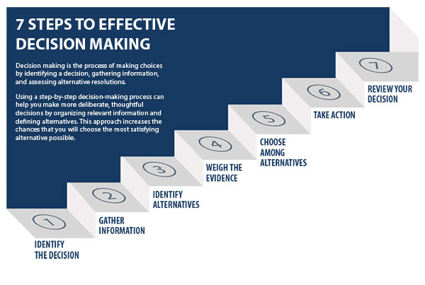

Slide 11

Types of Decision Making
Routine and Strategic Decisions
Policy and Operating Decisions
Organisational and Personal Decisions
Programmed and Non-Programmed Decisions
Individual and Group Decisions

Slide 12

What is Conflict?
Hocker and Wilmot (2001) defined conflict as an expressed struggle between interdependent parties over goals which they perceive as incompatible or resources which they perceive to be insufficient.

Slide 13

Functional vs. Dysfunctional Conflict
Functional = supports the goals of the group and improves its performance
Dysfunctional = hinders group performance
Task conflict = occur over content and goals of the group
Relationship conflict = interpersonal relationships
Process conflict = how work gets done

Slide 14

Five Modes For Conflict Resolution
Competing
Collaborating
Accommodating
Avoiding
Compromising

Slide 15

Negotiation
Negotiation is a method by which people settle differences. It is a process by which compromise or agreement is reached while avoiding argument and dispute.

Slide 16

The Negotiation Process
Preparation
Discussion
Clarification of goals
Negotiate towards a Win-Win outcome
Agreement
Implementation of a course of action

